Slide 1
Walmart Retail Stores Sales Analysis & Forecasting
Animesh Choudhary
Justin Martinek
Mukesh Raman
Dier Gao

Slide 2
Agenda
Background
Data Description
Data Exploration
Data Challenges
Data Clustering
Data Imputation
Compare & Contrast Clusters
Residual Analysis
Recommendations
Questions

Slide 3
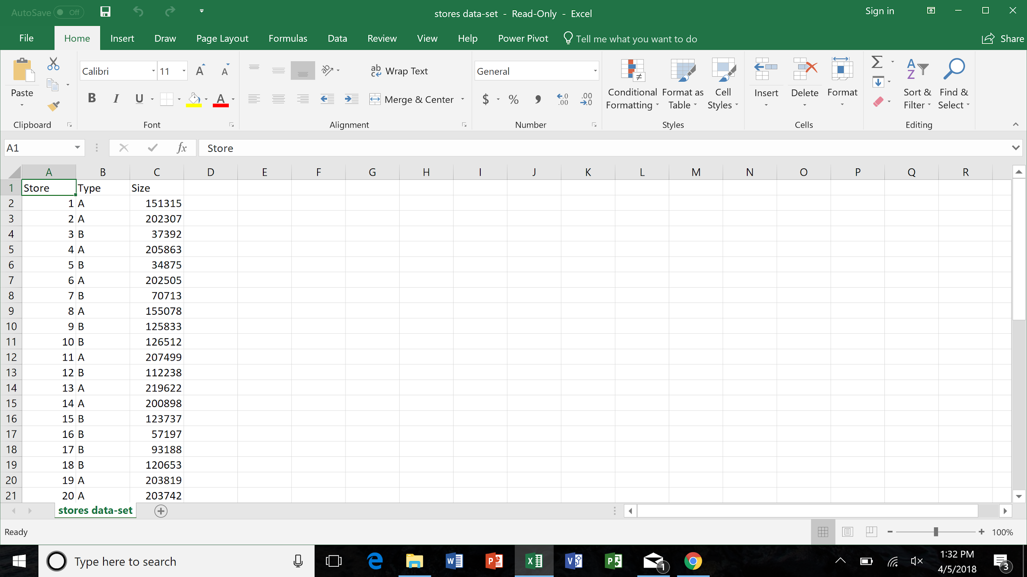
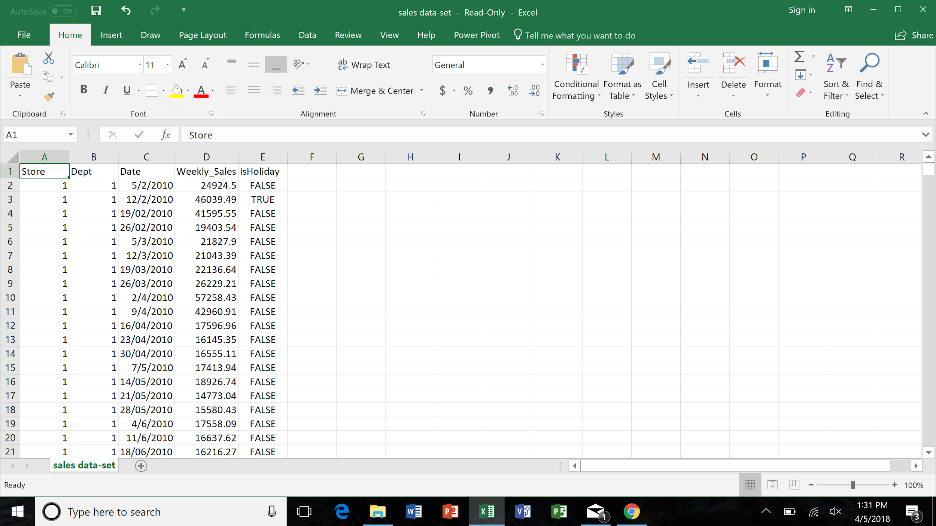
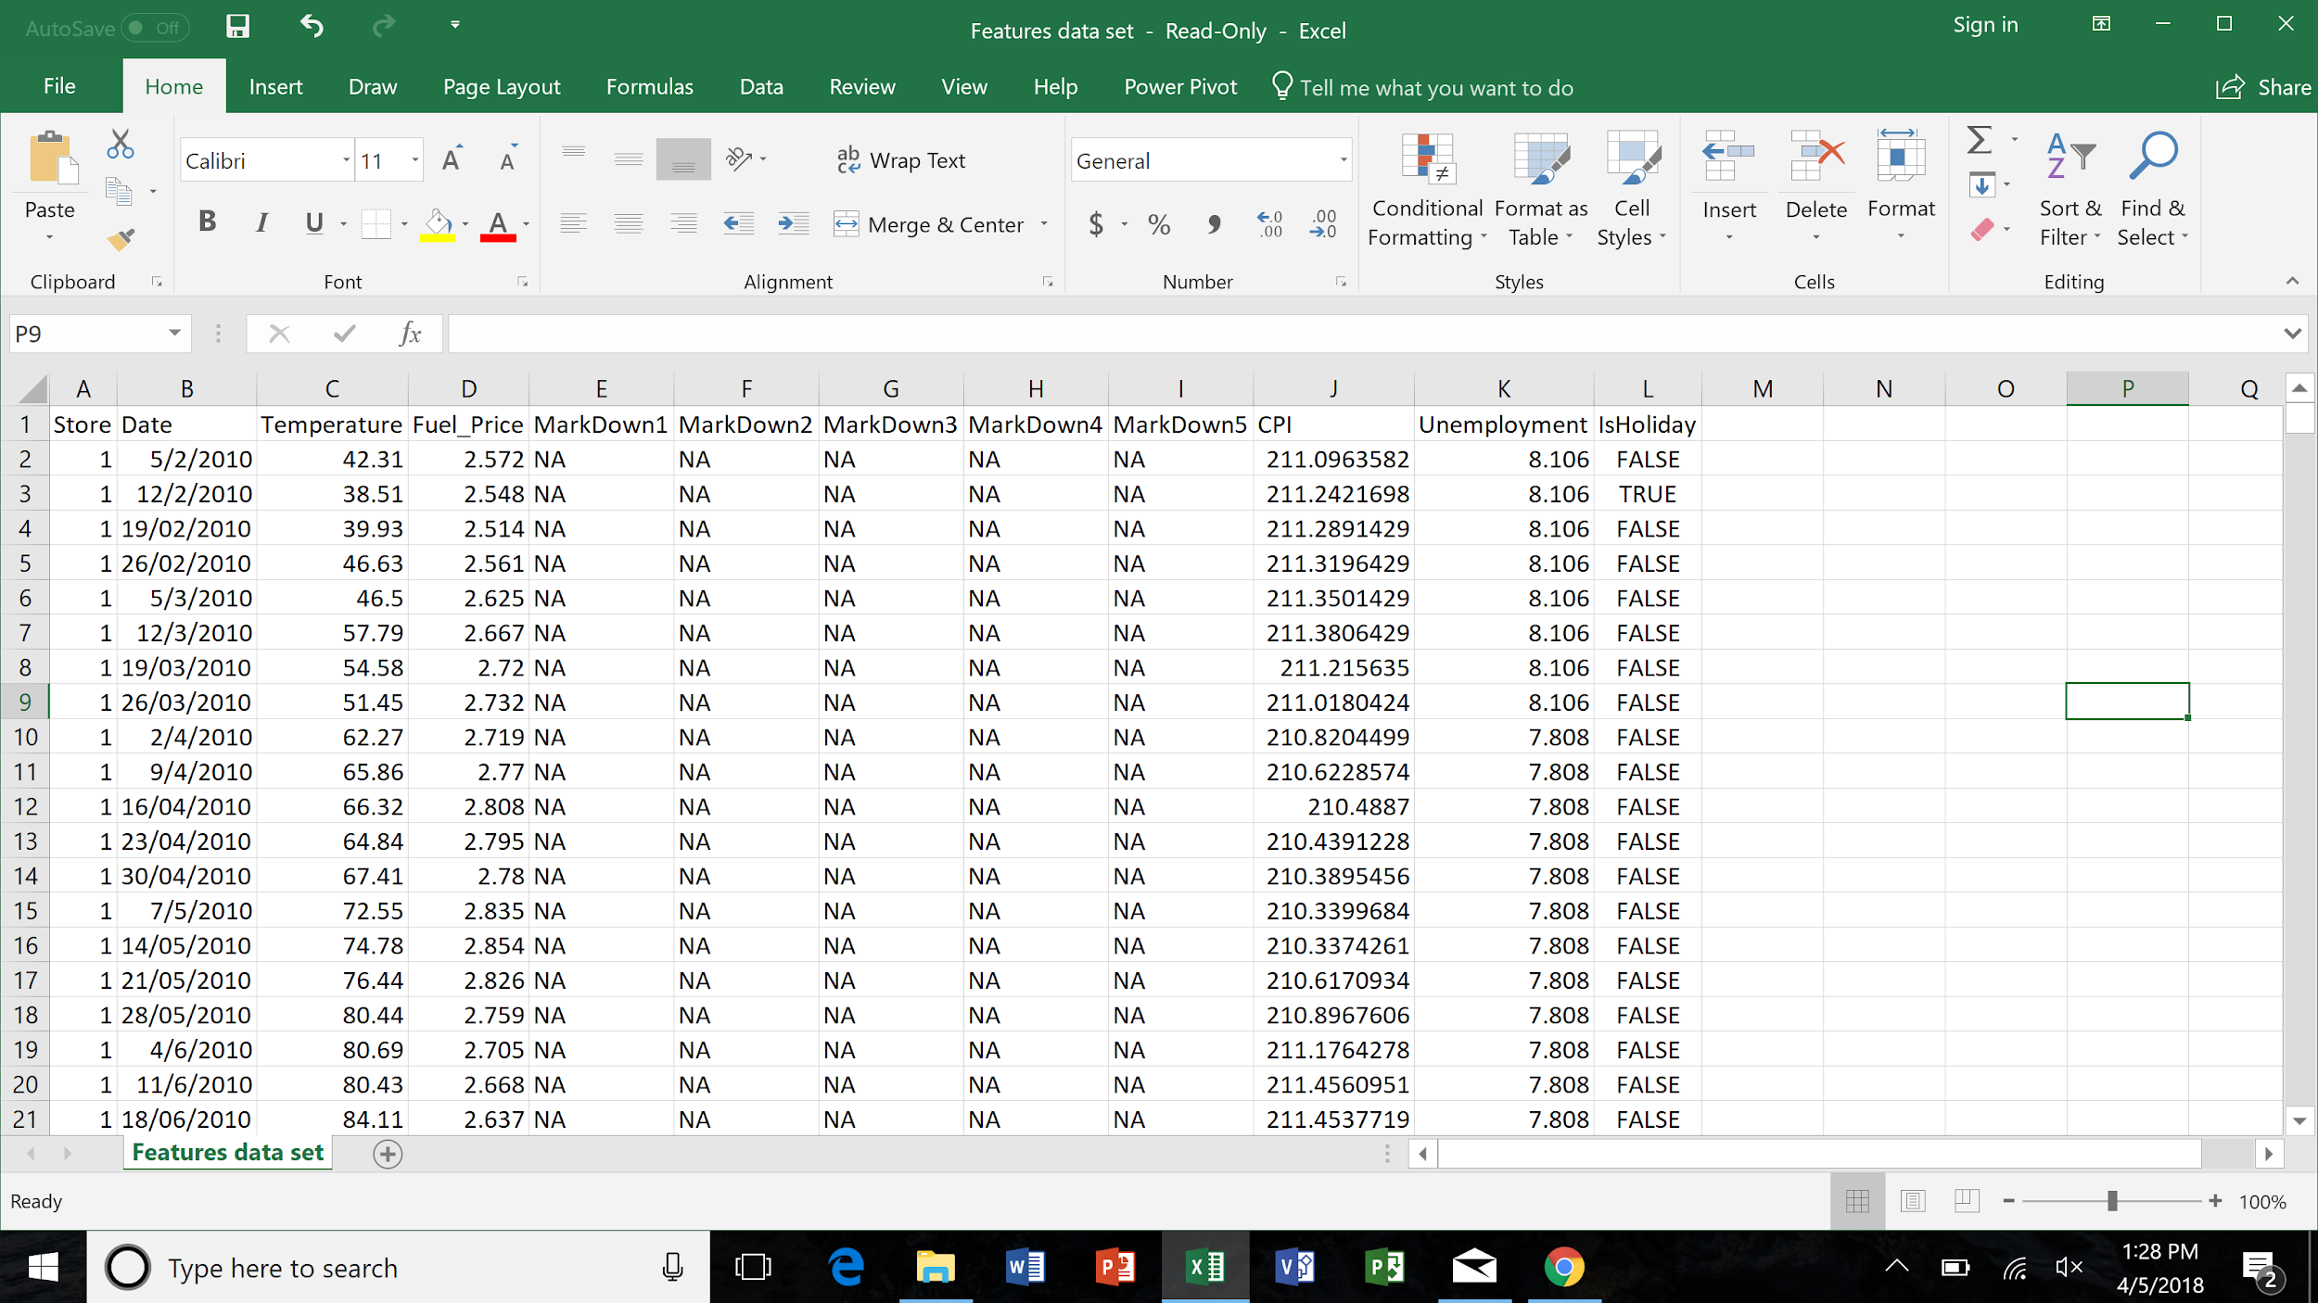
Background
Weekly sales figures for 45 brick and mortar stores - various sizes
Data range of January 2010 thru December 2013
Features Data Set - 8191 rows, 12 columns
Sales Data Set - 421,571 rows, 5 columns
Stores Data Set - 45 rows, 3 columns

Slide 4
Data Description
Prediction Variable - Weekly Sales for next 3 Quarters
Raw Data Variables
Sales Amount
Date
Store Size
Temperature
Unemployment Rate
Holiday
Fuel Price
Variable Description
Provided in $’s
MM/DD/YYYY
Square Footage
Deg. Fahrenheit
Provided as #.###%
True/False
Provided in $’s

Slide 5
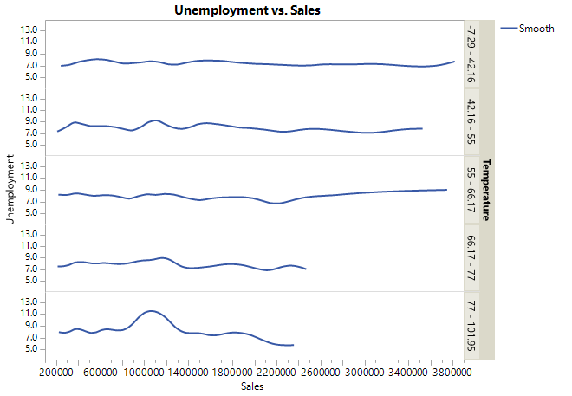
Data Exploration
Sales peaks actually show to be smaller in the warmer temperatures of 66.17-101.95
The cooler months actually show increased sales as Unemployment is higher. This is reflected in the right side tails of the cooler temps of -7.29 – 66.17

Slide 6
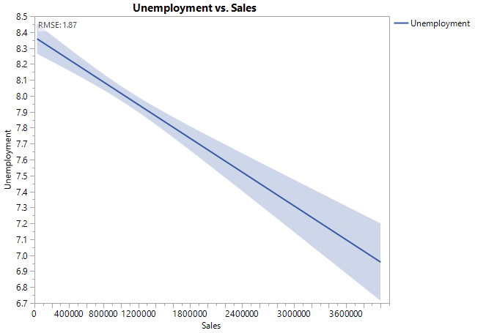
Data Exploration
As anticipated, negative correlation does exist between Unemployment and Sales
RMSE of 1.87

Slide 7

Challenges
Inconsistent Date Format in the original dataset
Inability of SAS to create multiple time series
Missing Markdown Values
Missing CPI Values
Missing Unemployment Rates
Inability to use store size directly as one of the regressors to determine its effect on the sales
Special Events/Occasions not present in the data
Unclear relation Between Markdowns and Discounts

Slide 8
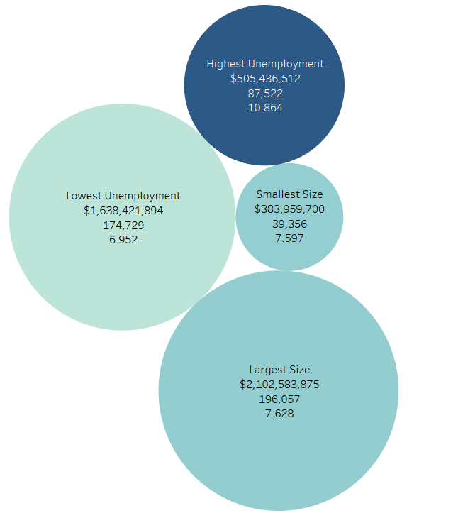
Data Clustering
The 45 stores were clustered based on their average of attributes such as size, unemployment rate, temperature, fuel price and CPI using Hierarchical Clustering
Cluster | Number of Stores
Highest Unemployment | 9
Lowest Unemployment | 5
Smallest Size | 6
Largest Size | 8
Notes:
The Size in the Image represents the size of the store, the intensity of the color represents the unemployment rate in that cluster.
The Smaller and the Larger size clusters have almost the same Unemployment rate.

Slide 9
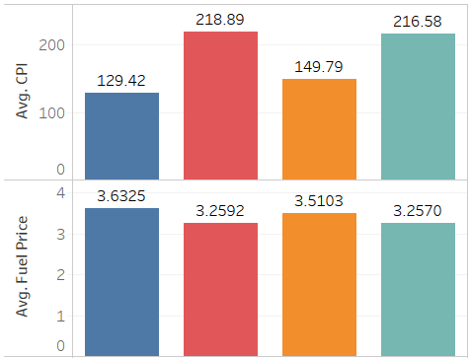
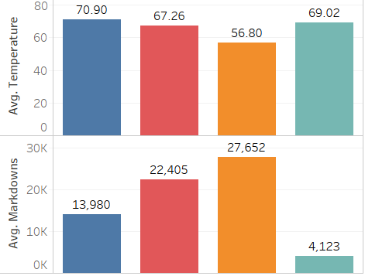
Cluster Overall Attributes
Notes:
These are the overall attributes of the 4 clusters. *Explain each graph by what is seen in it*

Slide 10
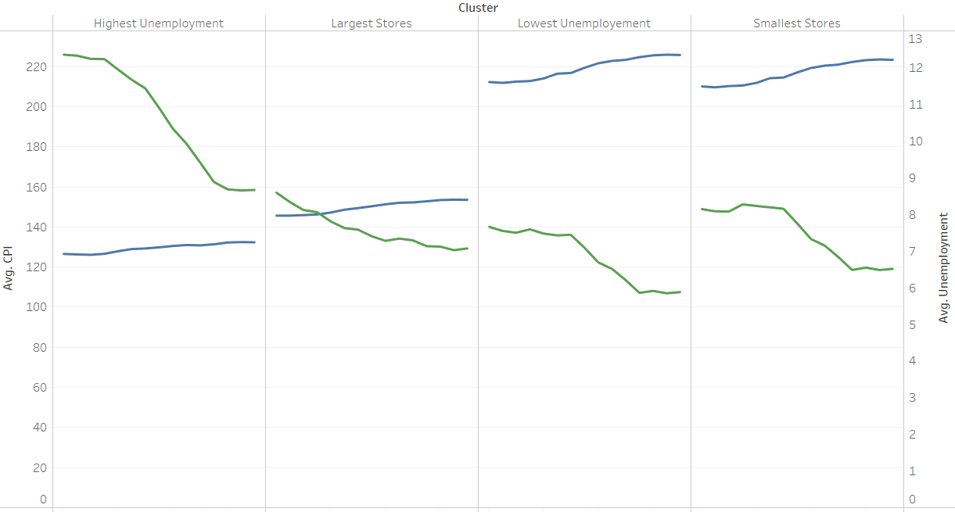
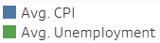
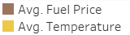
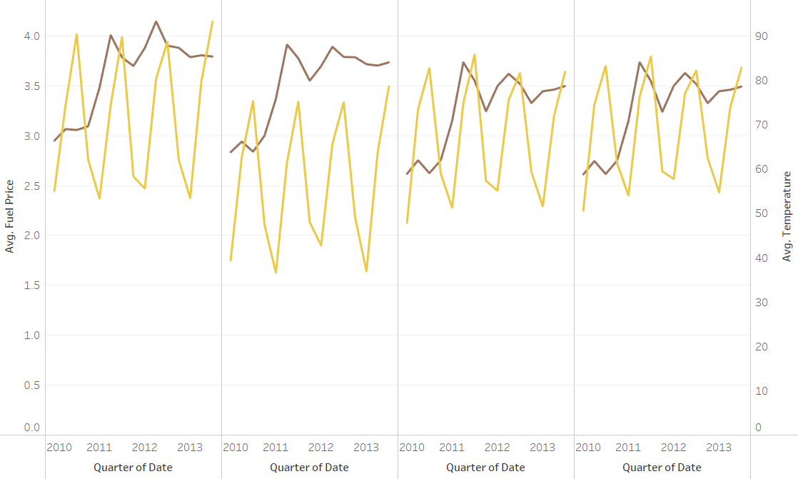
Cluster Attributes Variation
Notes:
Looking at variation of the various attributes makes more sense than the overall attributes because their variation over time dictates the sales more than their averages.

Slide 11
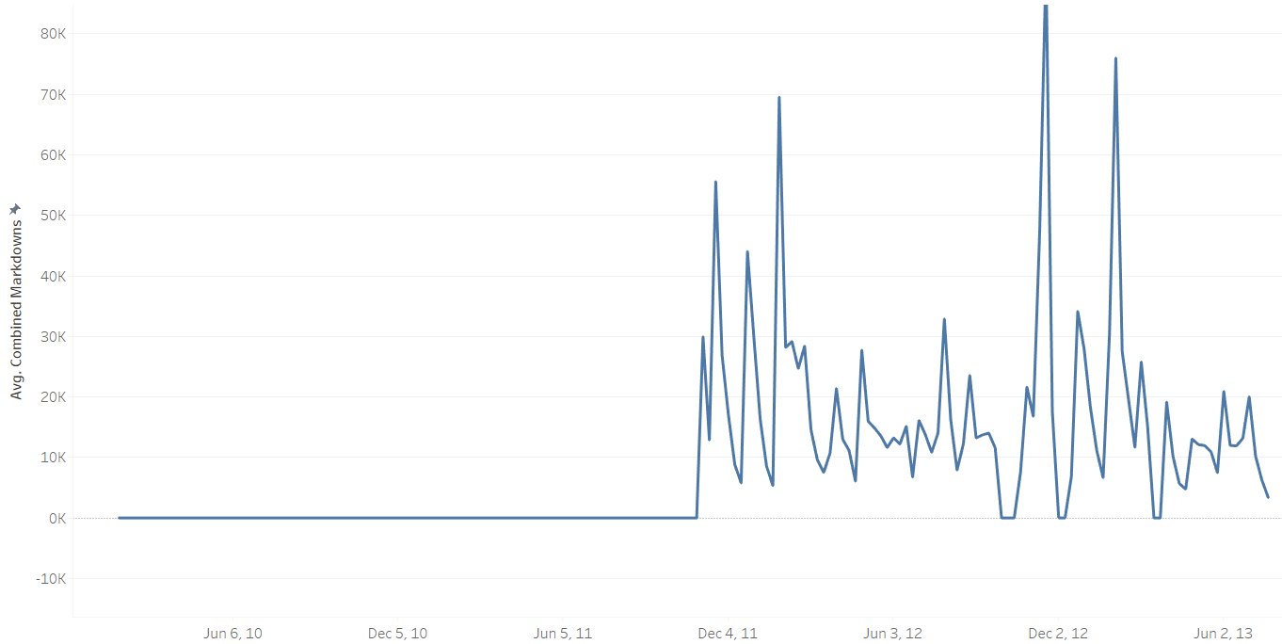
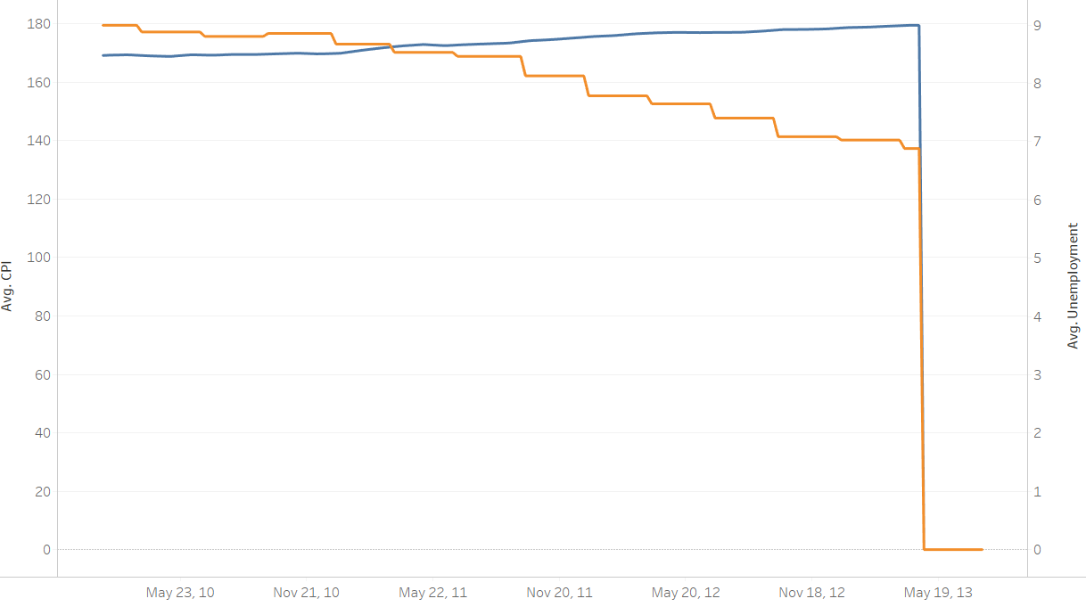
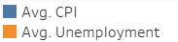
Data Imputation
Markdowns:
Missing for the initial 92 weeks
Cannot be all assumed to be 0 for all the initial weeks
Imputed by using the average markdowns of the same week across all the years
Imputed independently for all clusters and markdowns
CPI & Unemployment:
Missing for the last 13 weeks of test set
Cannot be assumed to be 0
Imputed by using the average values of the various weeks in the last year
Imputed independently for all clusters

Slide 12
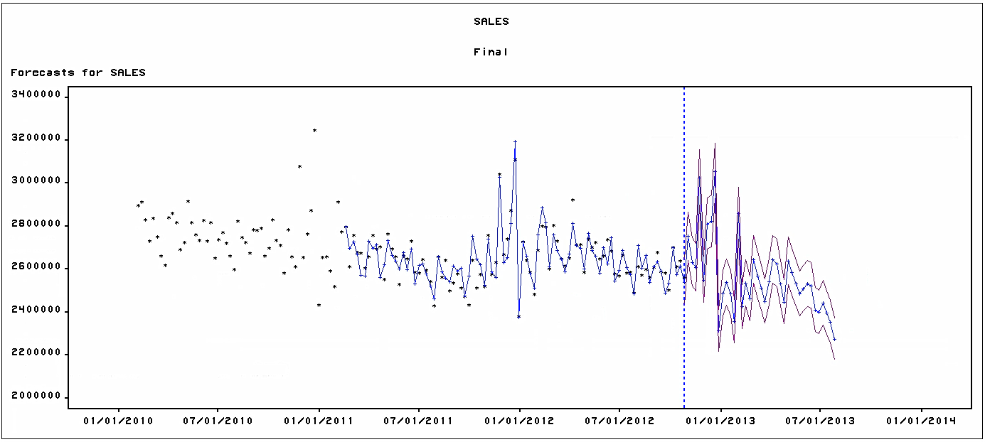
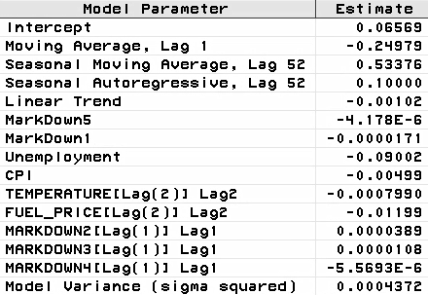
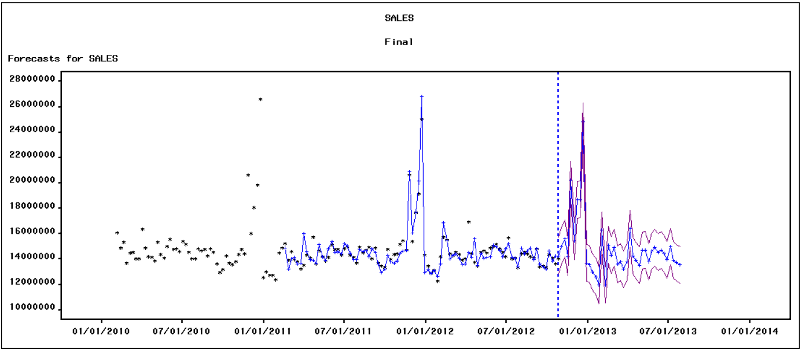
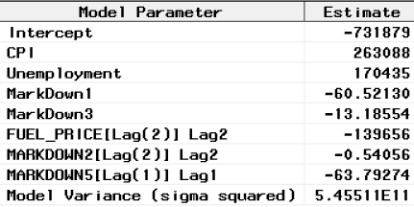
Compare & Contrast - Store Size
Small Stores
Large Stores
Notes:
Large Stores: ARIMA(0,1,0)s
Small Stores: ARIMA(0,0,1)(1,1,1)s

Slide 13
Compare & Contrast - Store Size
Factors Influencing Sales among these 2 clusters based on the model:
Small Stores | Large Stores
CPI | CPI
Unemployment Rate | Unemployment Rate
Fuel Price | Fuel Price
Markdown1 | Markdown1
Markdown2 | Markdown2
Markdown3 | Markdown3
Markdown4 | -
Markdown5 | Markdown5
Temperature | -
Avg. Size: 39,356 | Avg. Size: 196,057
$99,765,634 | $579,372,780
Dynamic Regressor
Ordinary Regressor
High Unemployment Rate

Slide 14
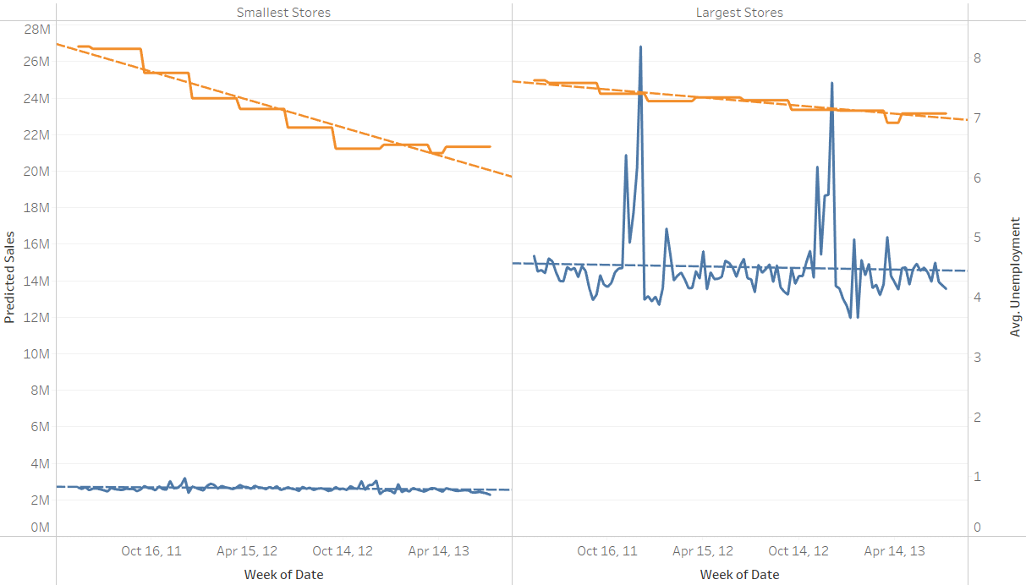
Compare & Contrast - Store Size

Slide 15
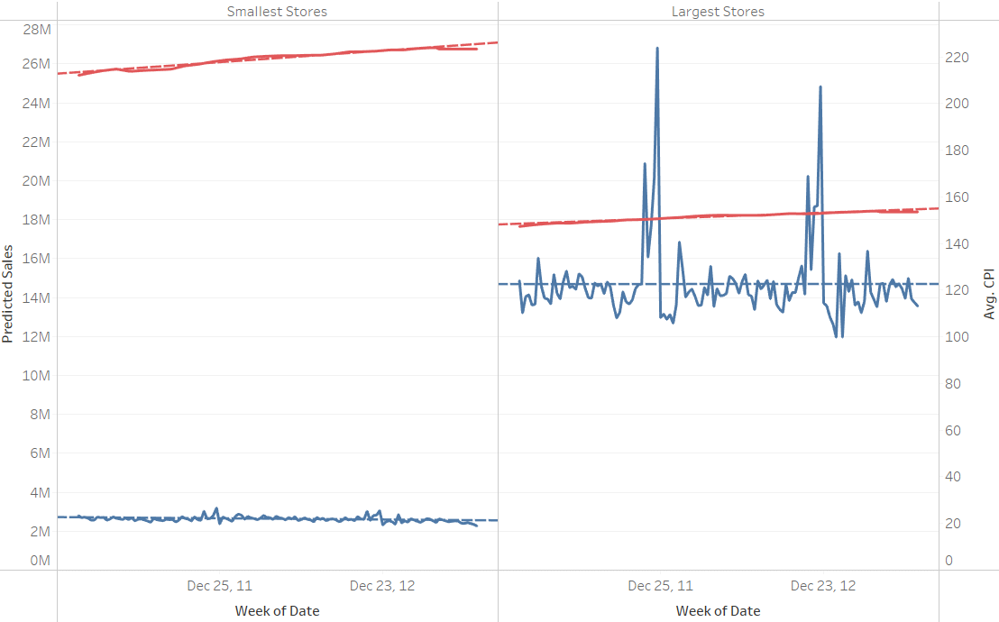
Compare & Contrast - Store Size

Slide 16
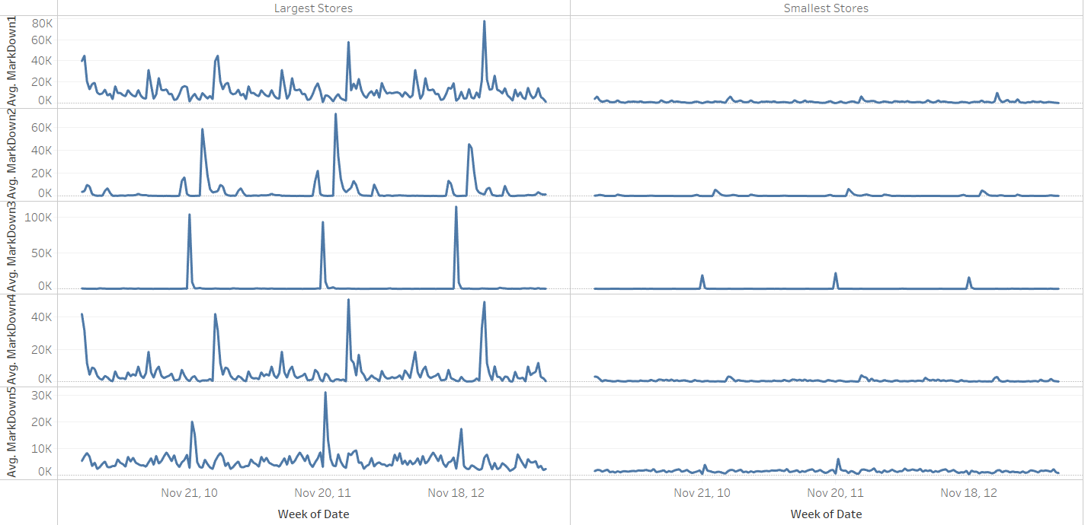
Compare & Contrast - Store Size

Slide 17
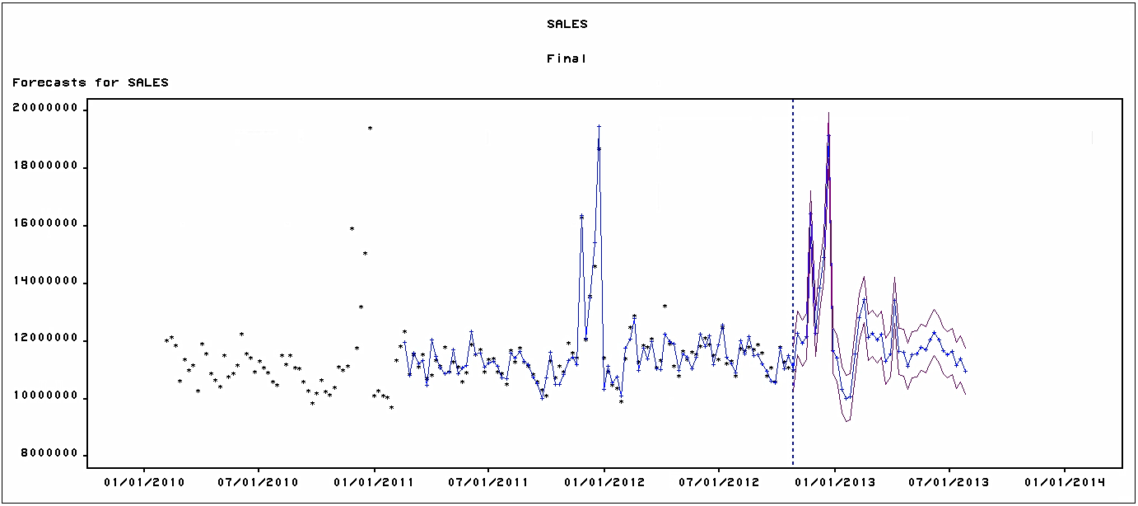
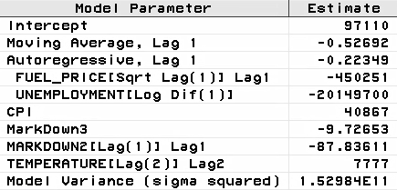
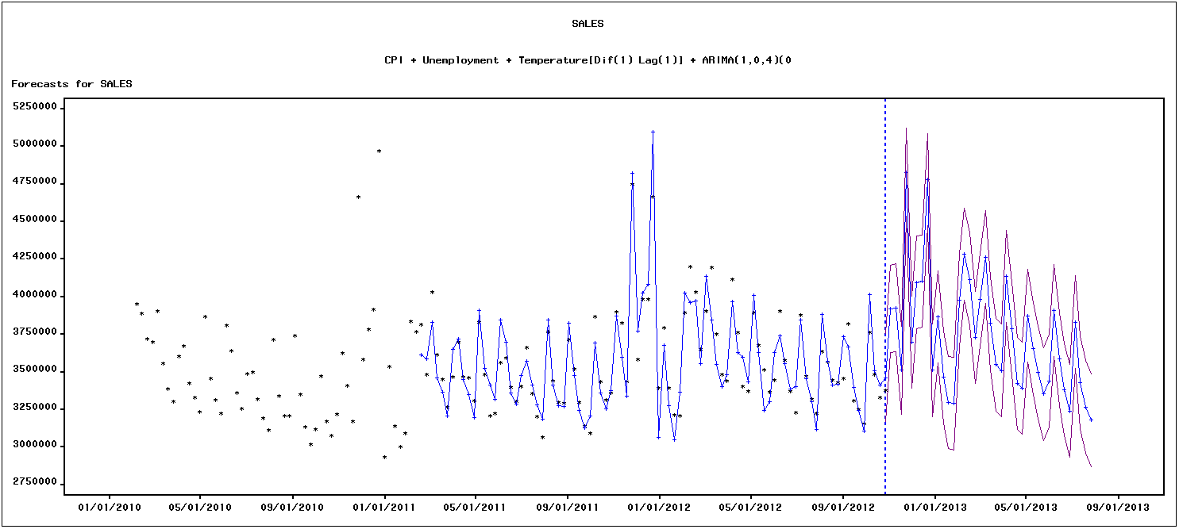
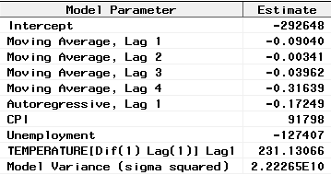
Compare & Contrast -Unemployment
Low Unemployment Rate
High Unemployment Rate
Notes:
High Unemployment: ARIMA(1,0,4)(0,1,0)s
Low Unemployment: ARIMA(1,0,1)(0,1,0)s

Slide 18
Compare & Contrast -Unemployment
Factors Influencing Sales among these 2 clusters based on the model:
Stores in High Unemployment Areas | Stores in Low Unemployment Areas
CPI | CPI
Unemployment Rate | Unemployment Rate
Temperature | Temperature
- | Fuel Price
- | Markdown2
- | Markdown3
Avg. Size: 87,522 | Avg. Size: 174,729
$145,917,798 | $475,102,022
Dynamic Regressor
Ordinary Regressor
High Unemployment Rate
Notes:
Fuel Price does not affect stores at High Unemployment Areas because people tend to prefer public transport instead

Slide 19
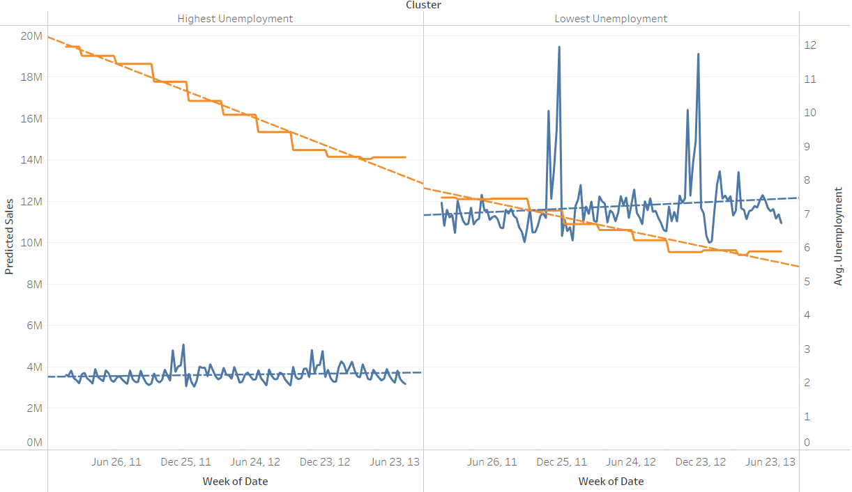
Compare & Contrast -Unemployment
Notes:
The relationship between the unemployment rates and the sales is pretty similar in both the cases:
As the unemployment rate goes down as seen through the trend line, there is a slight increase in the overall sales.
Even though the sales in the High UE stores is pretty low compared to the Low UE stores, the UE rate does not seem to be the reason behind such a drastic difference.

Slide 20
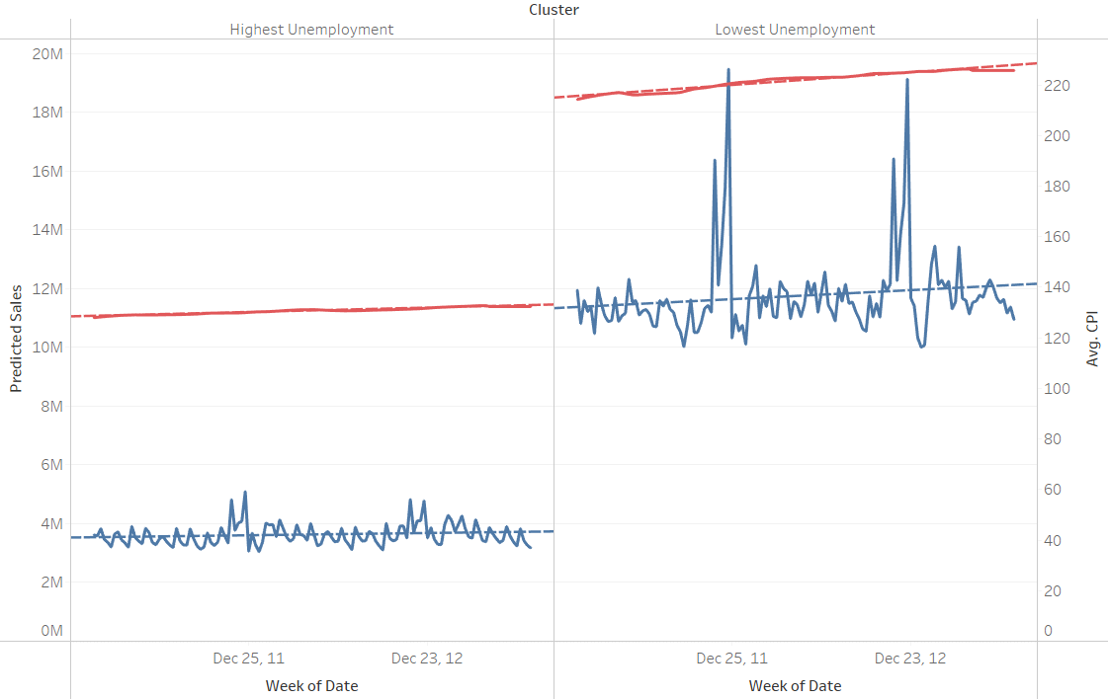
Compare & Contrast -Unemployment
Notes:
With Respect to the CPI also, both the clusters seem to have a similar performance

Slide 21
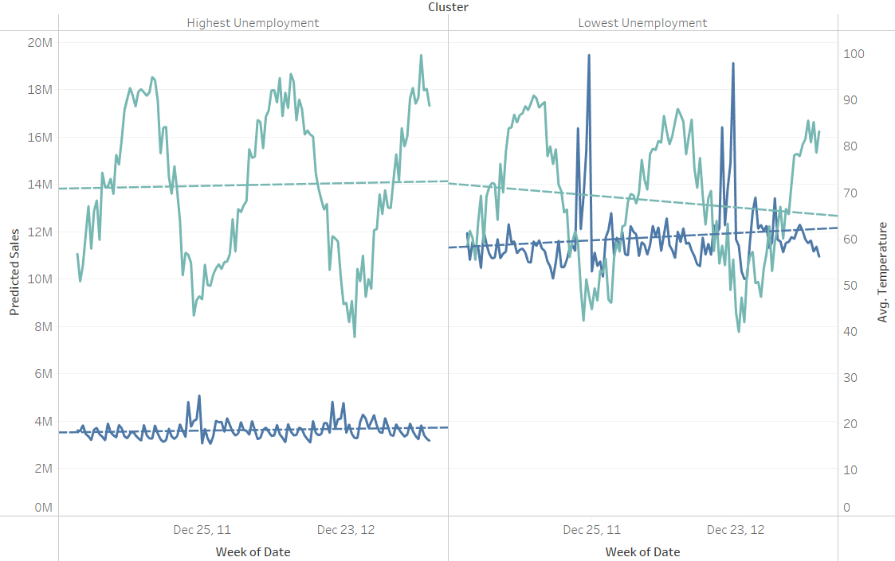
Compare & Contrast -Unemployment
Notes:
The temperature also seems to have a similar behaviour in both the kind of stores.
It is seen that when the temperature falls below 60 degrees, the sales seem to go up.
It may be because occasions like Christmas tend to fall during the winter but on other colder days also, the sales can be seen to be higher.

Slide 22
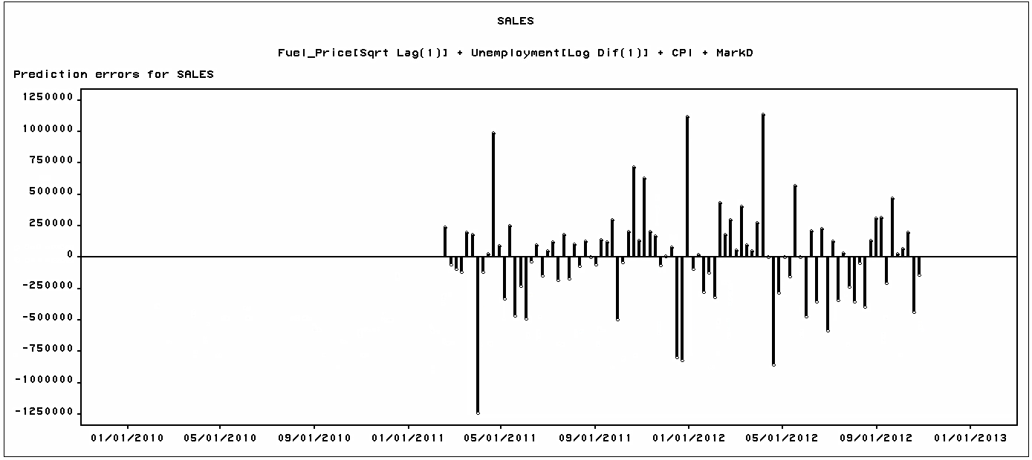
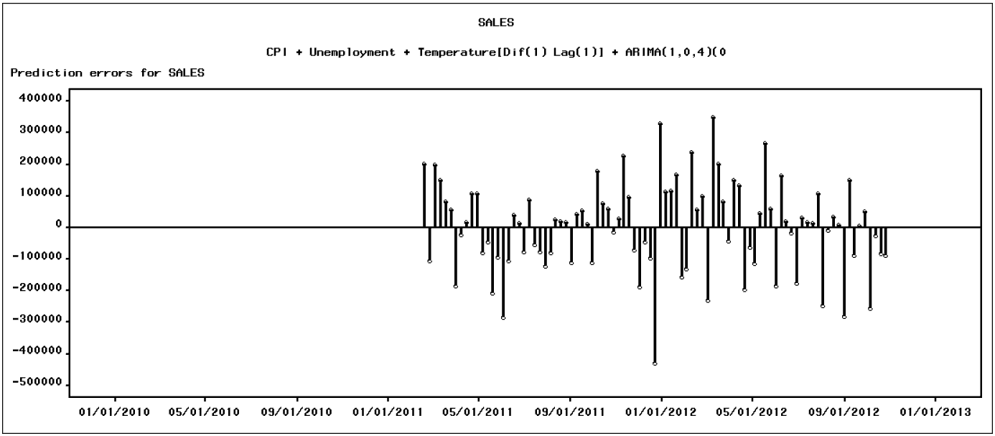
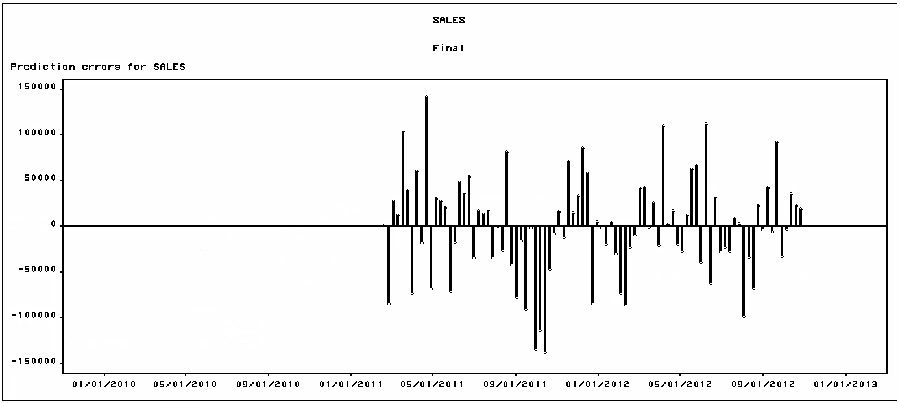
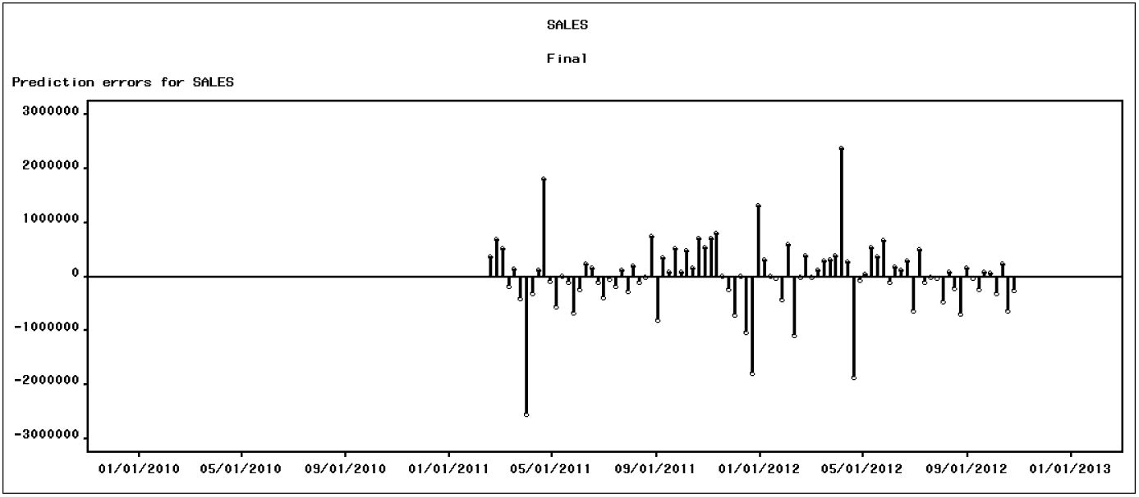
Residual Analysis
Low Unemployment Rate
High Unemployment Rate
2
4
4
2
1
3
3
1
Small Stores
Large Stores
2
4
2
4
1
3
3
1

Slide 23
Handling Events
Event | Date | Occasion | Cause
1 | April 1, 2011 | None | Falls on Good Friday week of previous year
2 | April 22, 2011 | Good Friday | Good Friday is on different week in each year
3 | Dec 23, 2011 | Christmas Eve | Different days which come in a week in different years
4 | April 06,2012 | Good Friday | Good Friday is on different week in each year
Notes:
The temperature also seems to have a similar behaviour in both the kind of stores.
It is seen that when the temperature falls below 60 degrees, the sales seem to go up.
It may be because occasions like Christmas tend to fall during the winter but on other colder days also, the sales can be seen to be higher.

Slide 24
Recommendations
Store Size:
Larger Stores lead to Higher Sales. The effect of all the external factors is massively overshadowed by the size of the store. So unless the management is restrained due to other factors such as legal compliance or excessive operating costs, they should invest in opening larger stores instead of smaller ones
Even in areas with High Unemployment rates, Larger stores can still perform better
Discounts:
Markdowns do not really have much impact in areas with High Unemployment rates
Spend more on Discounts in all other stores because they do lead to an increase in the sales
During winters, people tend to prefer Walmart over other stores. So investing in more promotions during winters can lead to potentially higher sales
Inventory Management should be done over forecasts aggregated at a monthly level and not weekly as that will be more robust to distribution of sales among the weeks
Monitor external factors like CPI, Unemployment Rate, Fuel Price and Temperature as they do tend to have an effect on the sales in most of the stores

Slide 25

Questions?

